Slide 2
INTERPRETATION OF TEST SOCRES

Slide 3
TOPIC:
ORDERING AND RANKING

Slide 4
ORDERING:
Definition:

Slide 6
ASCENDING ORDER:
Arranged from lowest to highest:
85, 9O, 95, 100, 110, 115, 125, 130, 135, 140

Slide 7
DESCNENDING ORDER:
Arranged from highest to lowest:
140, 135, 130, 125, 115, 110, 100,95,
90, 85

Slide 8
RANKING:
Definition:

Slide 9
Definition #2
Ranking:
Ranking is the relationship between two mathematical values where each value can be less than, greater than, or equal to the second value.

Slide 11
EXAMPLE:
RANK
SERIAL NO # SOCRES
1 62
2 53
3 45
4 45
5 39
1st
2nd
3rd
3rd
5th

Slide 12
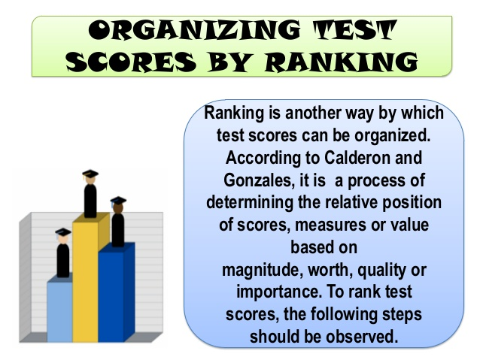

Slide 13
EXAMPLE:
Rank the following scores obtained by 5 students of class 2nd in mathematics test:
45, 62, 39, 53, 45

Slide 14
EXAMPLE:
RANK
SERIAL NO # SOCRES
1 62
2 53
3 45
4 45
5 39
1st
2nd
3rd
3rd
5th

Slide 15
Types of Ranking:
There are three main types of ranking:
Standard competition ranking
Ordinal ranking
Fractional ranking

Slide 16
Standard competition ranking:
Definition:
Standard competition ranking, or SCR, is a ranking system in which the mathematical values that are equal are given equal rank and the next, lesser value is given the next highest rank.

Slide 17
EXAMPLE: Our order is: 62, 53, 45, 45, 39, 34, 29.5, 28.5, 20 .
According to this order, the first student scored 62 marks , second student 53 marks, but we have a problem when it comes to third place. There are two same score 45 marks. According to standard competition ranking, the mathematical values that are equal are given equal rank and the next, lesser value is given the next highest rank. Therefore, both students would receive third place, and the student that have 39 marks would receive fifth place.
Notice that we skipped fourth place. For this particular ranking system, in this situation, fourth place does not exist because of the third place tie.

Slide 18
2. Ordinal ranking:
Definition:
Ordinal ranking is a system of ordering where each mathematical value is given a certain position in a sequence of numbers where no positions are equal
.

Slide 19
EXAMPLE:
Let's move on to ordinal ranking. We already ordered our data, so let's take a look at it one more time:
62, 53, 45, 45, 39, 34, 29.5, 28.5, 20
According to the ordinal ranking system, each mathematical value is given a certain position in a sequence of numbers where no positions are equal. Therefore, the competition officials would have to come up with a way to break the tie,
An example of an arbitrary but consistent system would be to incorporate other attributes into the ranking order (such as alphabetical ordering of the competitor's name) to ensure that no two items exactly match.

Slide 20
3.Fractional ranking:
Definition:
Fractional ranking is a system of ordering in which the mathematical values that are equal are given the mean of the ranking positions.

Slide 21
EXAMPLE:
Now for fractional ranking. Once again, let's have a last look at our data:
62, 53, 45, 45, 39, 34, 29.5, 28.5, 20
According to the fractional ranking system, the mathematical values that are equal are given the mean of the ranking positions. Therefore, the competition officials would have to take third and fourth place and find the mean, like this:
FORMULA:
R=SN1+SN2/NTS
3 + 4 = 7/2 = 3.5

Slide 22
Importance of Ordering and Ranking:
Ranking students achievement.
Analyzing and evaluating research.
Important part of competitions.

